Slide 1
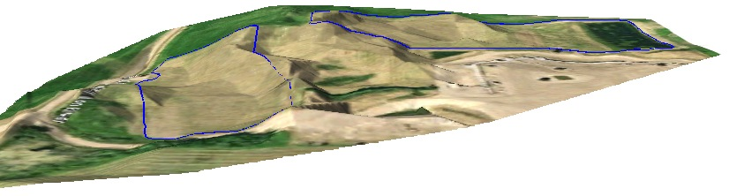
Introduction to GIS Short Course
April 27th and 28th, 2017

Slide 2
My Background
Not in GIS!
Environmental Science at Acadia
Environmental Scientist/Project Coordinator at GeoGrid Environmental
M.Sc. Geology at Acadia
Use Geographic Information Systems in all 3
Applied, Pragmatic approach to GIS

Slide 3
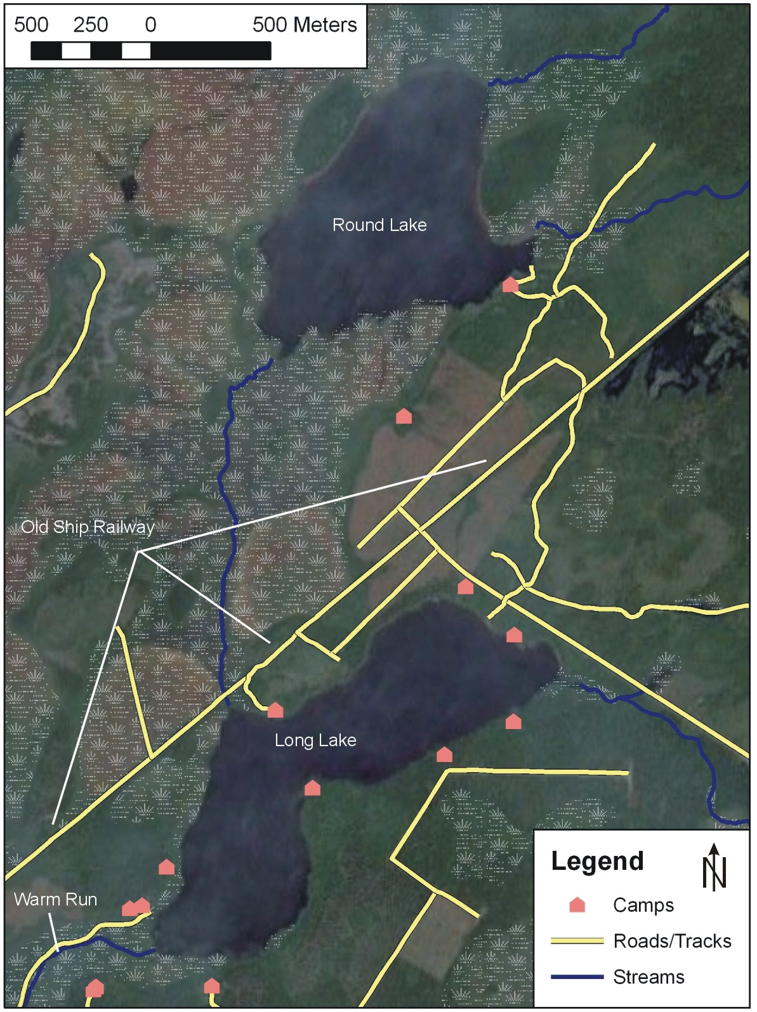

Slide 4
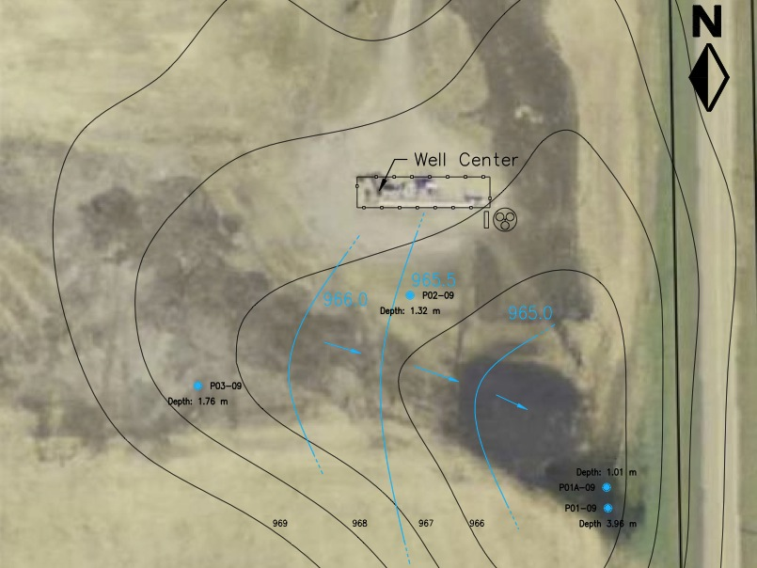
Elevation contours and water table contours of a spill site in Wimborne, Alberta

Slide 5
Cut and fill diagram of a site in Elk Point, Alberta
Excavated View
1989 View
Final Contour

Slide 6
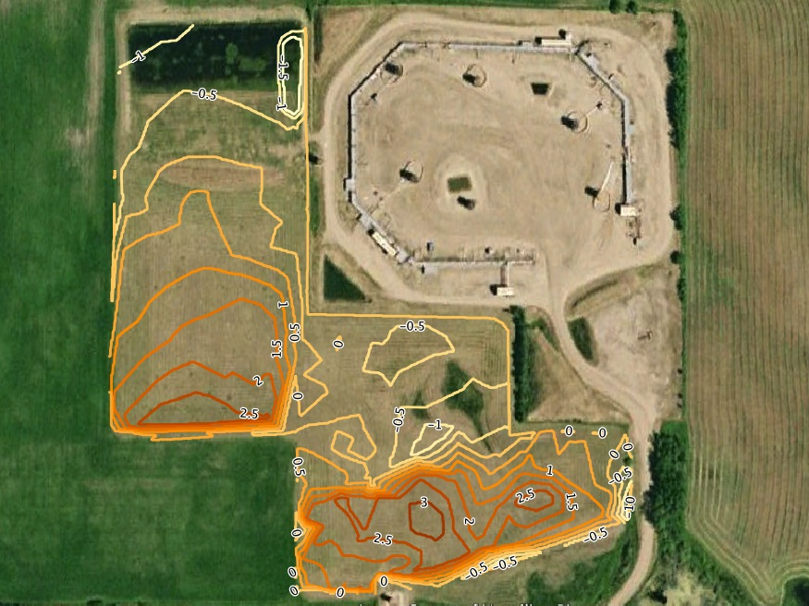
Cut and fill diagram of a site in Elk Point, Alberta

Slide 7
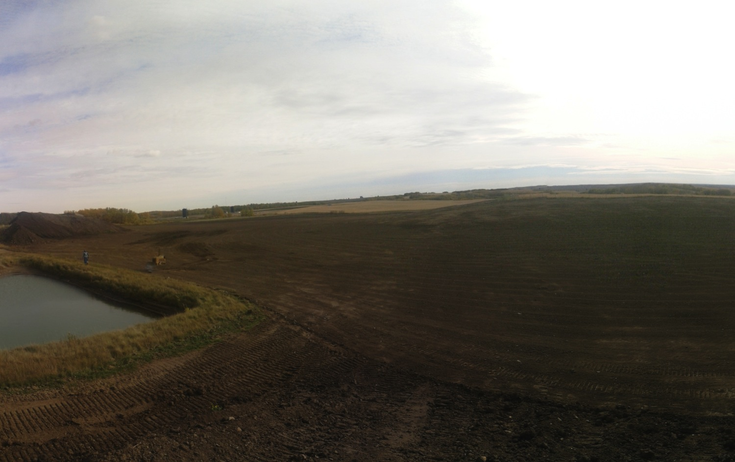

Slide 8
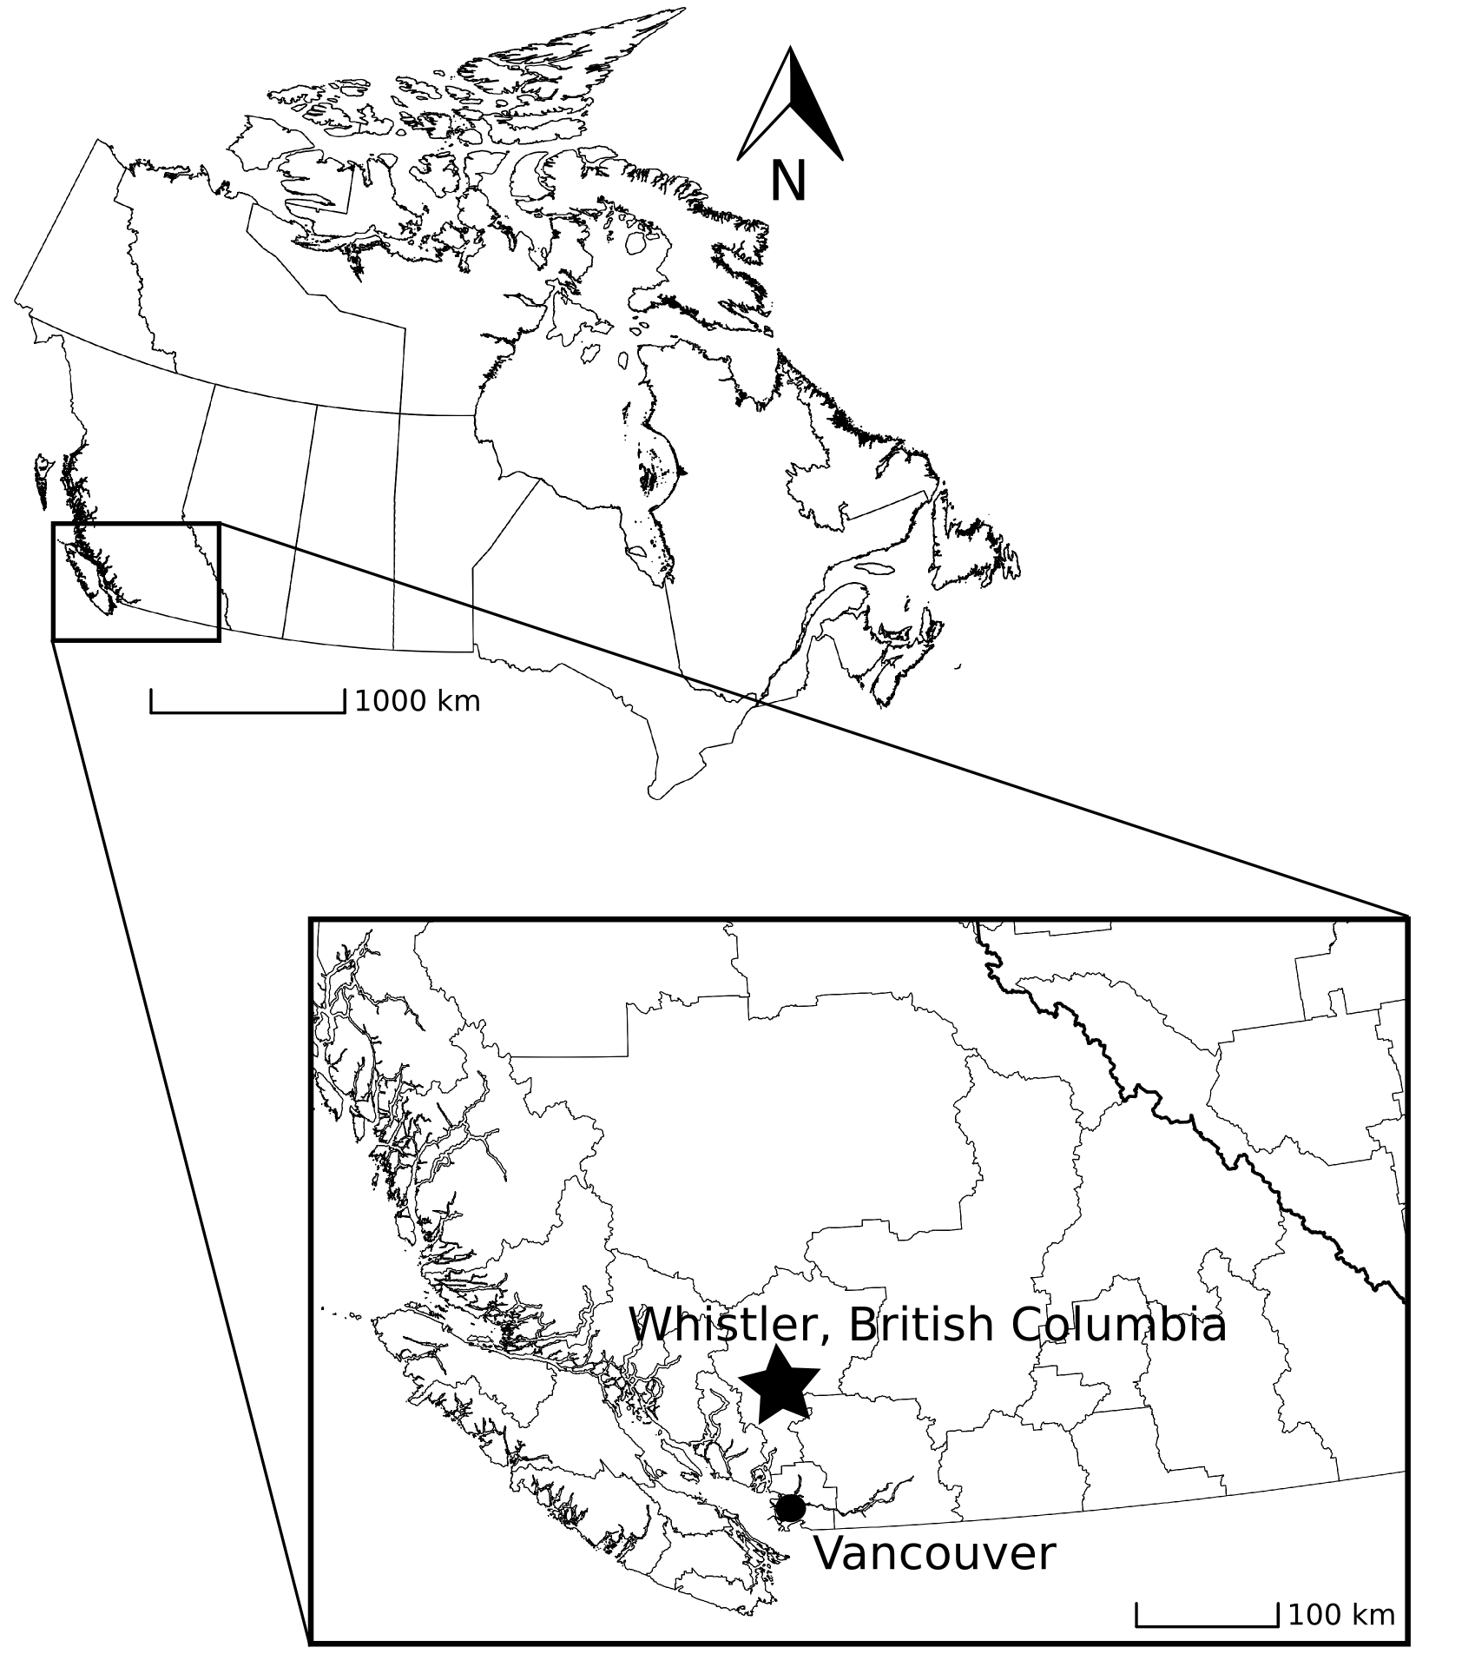

Slide 9
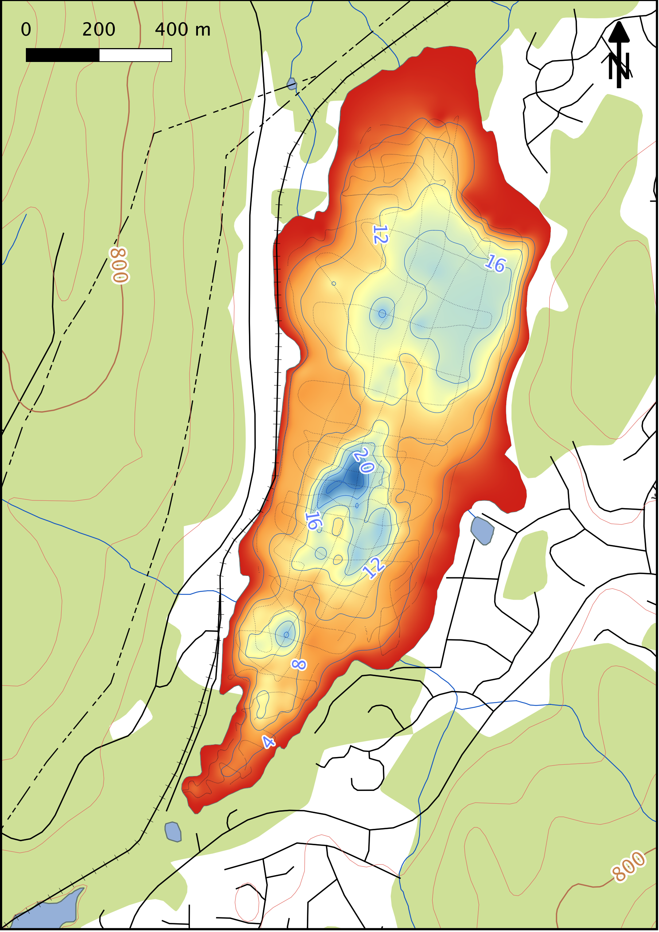

Slide 10
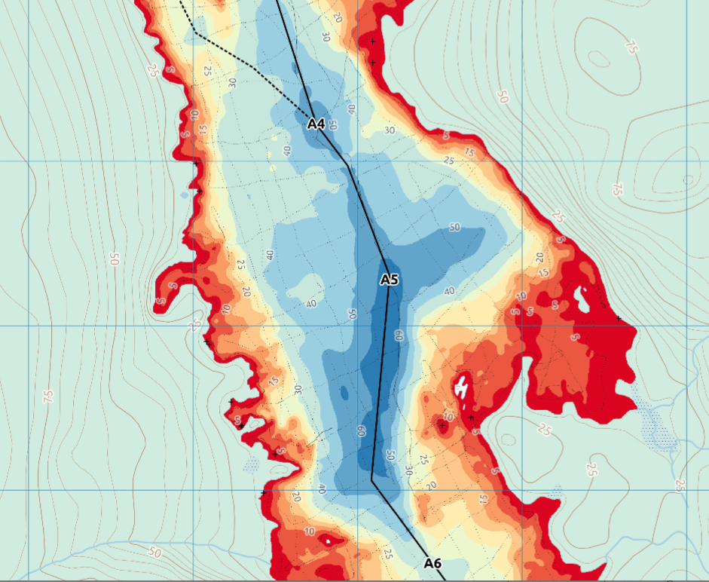

Slide 11
What is Geographic Information?
GIS = Geographic Information System(s)
Geographic Information is any information with a location associated with it (so, everything)
Any information you can put on a map
(and want to)

Slide 12
Standard NTS Topographic Map

Slide 13
Why do we bother?
Often a map is the best way to present and analyze information with a geographic component.
Maps allow us to view multiple types of information together (“layers”) to make connections.

Slide 14
Introduction to GIS Short Course
Day 1: How do you make a map in QGIS?
Add data to the map
Format the data to look pretty
Export/Print the map
Getting your data into QGIS

Slide 15
Introduction to GIS Short Course
Day 2: Creating, importing, and manipulating GIS Data
Make a map of your study sites
Create and edit data in QGIS
Interpolation and contouring (Raster processing)
Vector data analysis
Going over participant projects

Slide 16
Assignments
During each module you will:
Create a QGIS Project
Create a PDF of the map you made in that module
Save the QGIS Project (and any data you generate during that module) in the correct folder.
You “must” complete these tasks!

Slide 17





GIS Applications
GIS = Programs that work with geographic data
Google Earth (free to $400/year)
ESRI ArcGIS ($1500 base license, $4000 per extension; free basic versions available)
GRASS, QGIS (“free” or by donation)
MapInfo ($1995)
Whitebox GIS (also free)

Slide 18
GIS Applications
All have same set of features:
Basemaps
Ability to add/edit/view geographic data (some free versions don’t allow editing)
Analysis Tools
We will be using QGIS because:
It doesn’t cost money to install
It works (and works well) on multiple platforms
There is no license restriction (you can use it forever)

Slide 19
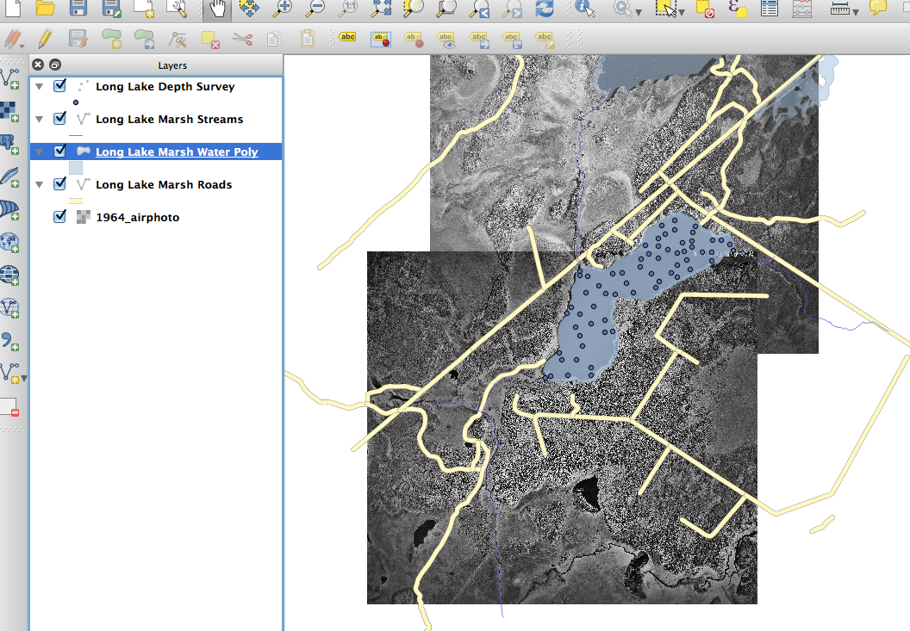
How is GIS Data Organized?
GIS Data is organized in layers
Each layer contains similar data that is usually displayed in a similar way.
Layers

Slide 20
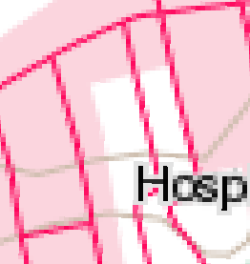
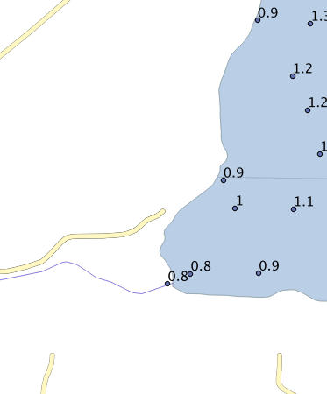
Types of Layers
Raster Layers
Contain a grid of data with a data value in each square
Can be color data (like a picture)
Can be other data (like elevation, concentration)
Vector Layers
Contain a collection of points OR lines OR polygons (“features”)
Also contain data about these features (Sample number, elevation, depth, strike, dip; known as “attributes”).
The power of GIS if often in comparing layers with each other and examining relationships.

Slide 21
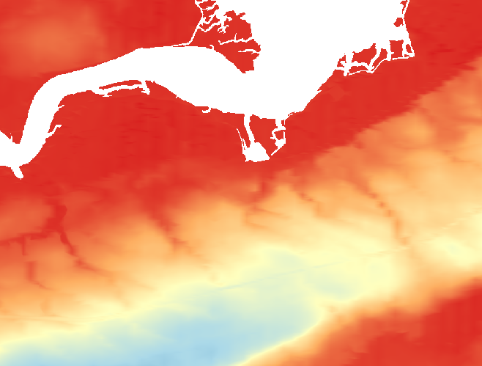
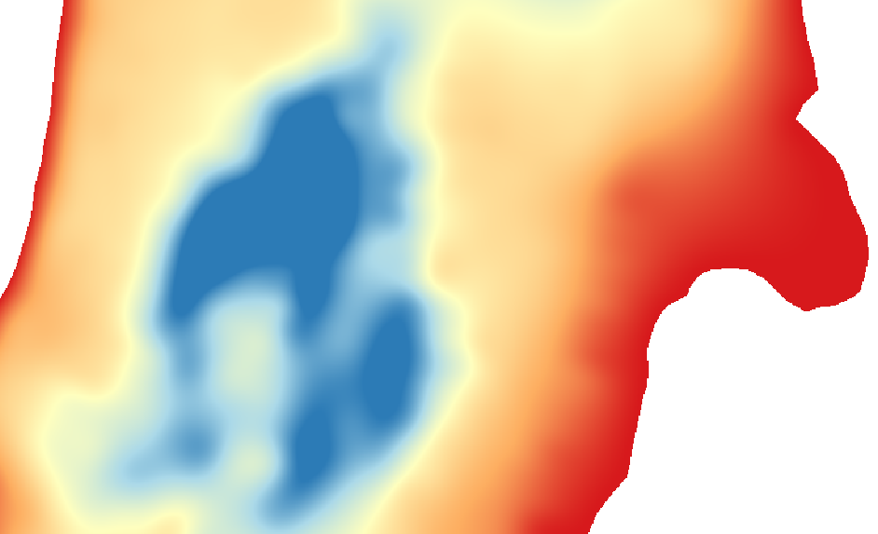

Raster Layers
Can be displayed in a variety of ways – “color ramp” (shown below), grayscale, several discrete colors.
For any point on the map, you can obtain a value from a raster.
Also called a “surface”

Slide 22
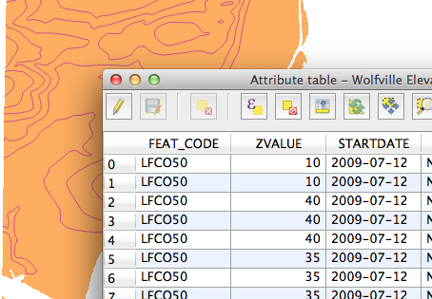
Vector Layers
Made up of one or more “features” that have “attributes”
Point OR line OR polygon features in a single layer

Slide 23
Vector Data
Points
Lines
Polygons
Features, Fields, Attributes

Slide 24
How could the following data be represented?
Soil conductivity (Points, Contours)
Water table depth (Points, Contours)
Sample locations (Points)
Strike & dip (Points, Contours)
Slope steepness & direction of slope (Points, Contours)
Roads (Lines, Polygons)
Habitat suitability (Polygons)
Bedrock type (Polygons)

Slide 25
Identify the “layers” present, and their types

Slide 26
Identify the “layers” present, and their types

Slide 27
Exercise!

Slide 28
Coordinate Reference Systems

Slide 29
Coordinate Reference Systems (CRS)
GIS Data (raster and vector) is represented by coordinates (X and Y).
These X and Y coordinates can mean any number of things!
Latitude, Longitude, UTM Easting, UTM Northing, Arbitrary XY data from a defined grid
Every GIS data file has a CRS, because X and Y coordinates must be represented somehow.

Slide 30
Projections (“Project CRS”)
Earth is a sphere (actually, an ellipsoid), so to represent it on something flat (your screen, a piece of paper) we need a projection.
Projections are never perfect, always distort some combination of shape (angles), scale (distance), and area.
Mathematically, projections convert Latitude/Longitude values (angles) to X/Y values (distances).

Slide 31
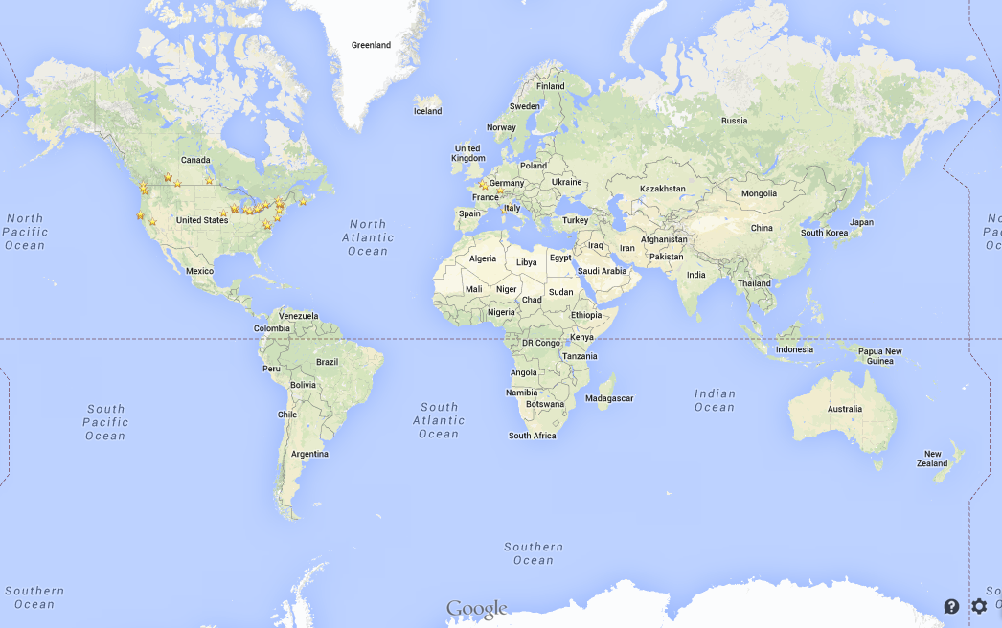
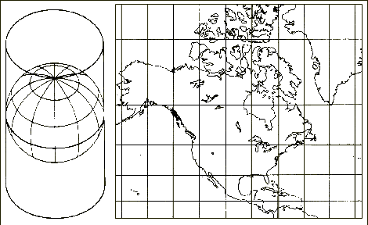
Mercator Projection
Y
X

Slide 32
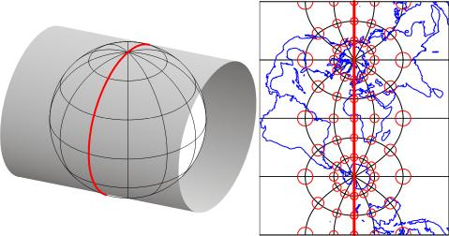
Transverse Mercator Projection
Low distortion for a very specific strip of the world
Used for local data
Y
X

Slide 33
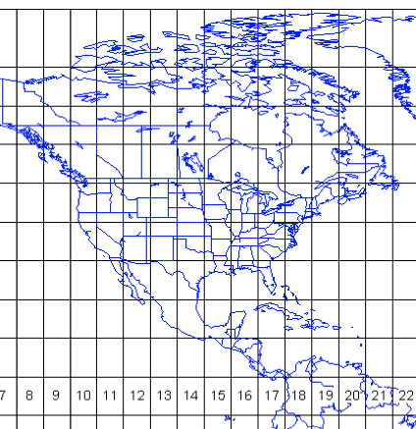
Universal Transverse Mercator Zones

Slide 34
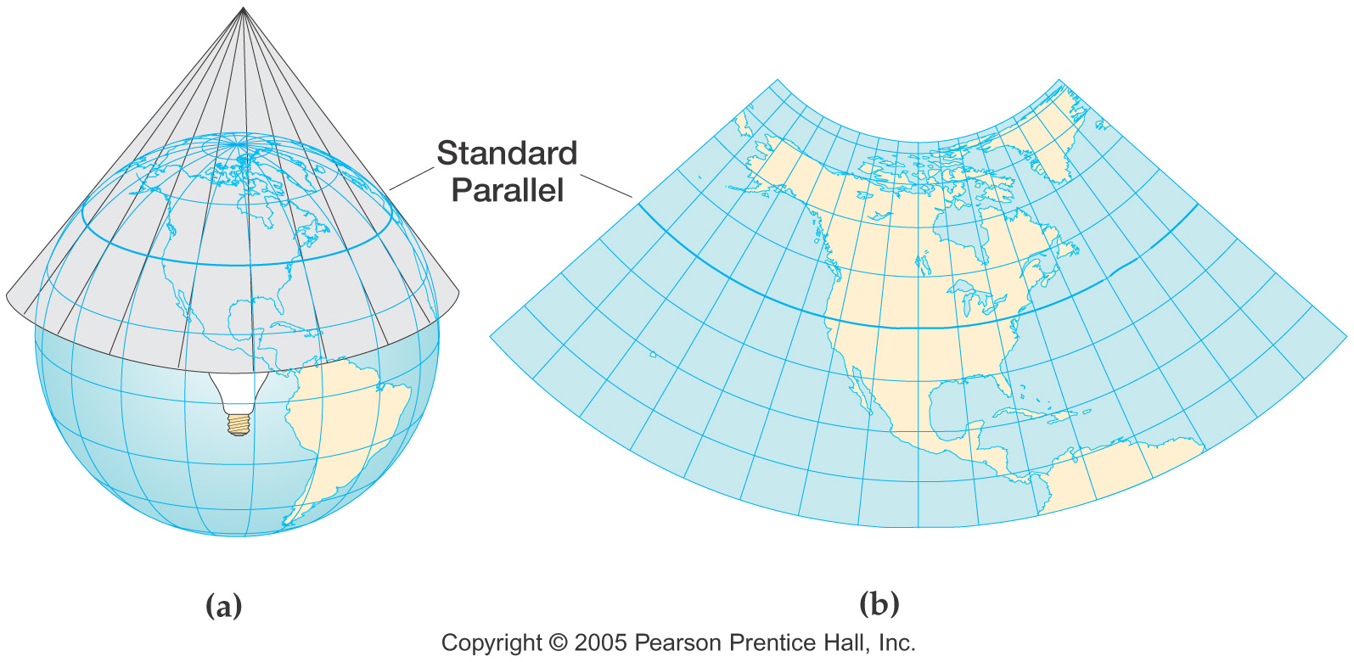
Conic Projection
Y
X

Slide 35
Projections
Coordinate Reference Systems
The XY coordinates of a particular dataset
Can be lat/lon (positions on the earth’s surface) or map coordinates (that can be related to lat/lon using a projection)
Earth’s Surface (Latitude, Longitude)
Projection
Map Coordinates (in distance units)

Slide 36
Projections/CRSs
Dataset (layer you add to QGIS)
The map you look at
Layer CRS/Projection
Dataset (layer you add to QGIS)
Project CRS/Projection
Layer CRS/Projection

Slide 37
Projections/CRSs
The CRS for a dataset can be projected (XY values in distance units) or geographic (latitude/longitude)
The projection in which you view geographic data can be different than the CRS of the dataset (“on-the-fly projection”)
If your data is not plotting in the right place, you have a CRS problem!

Slide 38
Common CRSs
WGS84 = Latitude/Longitude
NAD83 = Latitude/Longitude fixed for North American Plate
Nova Scotia is UTM Zone 20N
For small areas (less than 50-100 km across) use UTM!
For large areas (between UTM zones) use World Mercator or Albers Equal Area Conic
For the arctic, you may need to use other projections

Slide 39
Exercise!

Slide 40
Introduction to GIS Short Course
January 16th & 17th, 2016

Slide 41
What is Geographic Information?
GIS = Geographic Information System(s)
Geographic Information is any information with a location associated with it (so, everything)
Any information you can put on a map
(and want to)

Slide 42
Vector Data
Points
Lines
Polygons
Features, Fields, Attributes

Slide 43
Raster Layers
Can be displayed in a variety of ways – “color ramp” (shown below), grayscale, several discrete colors.
For any point on the map, you can obtain a value from a raster.
Also called a “surface”

Slide 44
Projections
Coordinate Reference Systems
The XY coordinates of a particular dataset
Can be lat/lon (positions on the earth’s surface) or map coordinates (that can be related to lat/lon using a projection)
Earth’s Surface (Latitude, Longitude)
Projection
Map Coordinates (in distance units)

Slide 45
Projections/CRSs
Dataset (layer you add to QGIS)
The map you look at
Layer CRS/Projection
Dataset (layer you add to QGIS)
Project CRS/Projection
Layer CRS/Projection

Slide 46
What Happened in Day 1
Adding data into QGIS
Zoom, pan, navigate around the map
Changing the layer style (raster and vector)
Export your map using the print composer

Slide 47
Making A Map
Prepare your data
Add your data
Make sure your data is in the right place (ensure correct CRS) and pick a Project CRS
Change the style of your layers
Export your map using a print composer (add north arrow and scale bar)

Slide 48
Outline for Day 2
Refresher
Make a map of Study Sites in Nova Scotia
Creating and Editing Vector Layers
Introduction to Raster Processing
Interpolation & contouring
Introduction to Vector Processing
Selecting vector data, manipulating vector data
Your questions/projects!

